Slide 1

Navigating the Latest Developments in School Law:
A Legal Update
N
W
E
Presented by Fred Stormer
and Jarod Russell
2025 WTAMU Board Workshop
May 21, 2025
S

Slide 2






Finding Our Way
Executive Orders
Expenditures
.
Grievances
.
Qualified Immunity
N
W
E
Employment
S
Open Meetings/ Governance

Slide 3
N
Expenditures
W
E
S

Slide 4
Edcouch-Elsa ISD v. Comp. Training Ctr.
The ISD contracted with two entities for grant-writing services on a contingency fee basis
The ISD terminated the contracts and refused to pay the fees ($780,000)
Vendor sued the ISD for breach of contract
2024 WL 3708934 (Tex. App.—Corpus Christi—Edinburg Aug. 8, 2024)

Slide 5
Edcouch-Elsa ISD v. Comp. Training Ctr.
The ISD asserted governmental immunity
Districts generally have an immunity from lawsuits, but there is a waiver for breach of contract claims
  Tex. Local Gov’t Code §§ 271.151-.152
A district waives immunity when it enters a contract that states the essential terms of the agreement for providing goods or services and is properly executed on behalf of the district

Slide 6
Edcouch-Elsa ISD v. Comp. Training Ctr.
TEC § 11.1511(c)(4) permits boards to “enter into contracts . . . and delegate contractual authority to the superintendent as appropriate”
Boards typically delegate purchasing authority through Policy CH (LOCAL)
Here, the ISD’s Policy delegated authority to the superintendent to make budgeted purchases, but required Board approval for any purchase that cost $25,000 or more

Slide 7
Edcouch-Elsa ISD v. Comp. Training Ctr.
The Board never approved the contracts and did not include the contracts in the ISD’s budget
The entities argued that when the contracts were signed, there was no expense to budget for and no purchase amount that would require board approval
Court of appeals rejected this argument, noting the Policy CH (LOCAL) did not permit the superintendent to make unbudgeted purchases “[m]erely because fees were not due at a contract’s inception”

Slide 8
Edcouch-Elsa ISD v. Comp. Training Ctr.
Court held the superintendent lacked the authority to enter the contract, so the contracts were not properly executed on behalf of the ISD and the ISD retained its governmental immunity

Slide 9

Takeaway
Ensure delegations of contracting authority are clear

Slide 10
Robstown ISD v. Alejandro
Vendor began providing business consulting services without a contract, earning $40,000 over 4 months
Superintendent then signed a contract with vendor for $28,500 to provide approximately 3 additional months of services
Superintendent was placed on paid administrative leave and then terminated
1 month into the contract, the acting superintendent terminated the contract without cause
2025 WL 555767 (Tex. App.—Corpus Christi—Edinburg Feb. 20, 2025)

Slide 11
Robstown ISD v. Alejandro
Vendor sued Robstown ISD for breach of contract
Robstown ISD asserted governmental immunity
The ISD’s Policy CH(LOCAL) authorized the superintendent to make budgeted purchases but required Board approval for “any single, budgeted purchase of goods or services that cost $50,000 or more”

Slide 12
Robstown ISD v. Alejandro
Robstown ISD argued the purchase was unauthorized because the contract was a continuation of the same services at the same compensation level
Court of Appeals rejected the District’s argument, noting the Policy required approval for “singles purchases” over $50,000
Robstown ISD did not have immunity from the breach of contract claim

Slide 13
Borgelt v. Austin Firefighters Association
Issue was whether “association business leave” under a collective bargaining agreement was an impermissible gift of public funds
Article 3, section 52 of the Texas Constitution prohibits the gift of public funds
This opinion did not modify existing precedent, but provided a simplified restatement of the law on gifts of public funds
692 S.W.3d 288 (Tex. 2024)

Slide 14
Borgelt v. Austin Firefighters Association
An expenditure is not a gift of public funds if three principles are satisfied:
  “(1) the expenditure is not gratuitous but instead brings a public benefit;
  (2) the predominant objective is to accomplish a legitimate public purpose, not to provide a benefit to a private party; and
  (3) the government retains control over the funds to ensure that the public purpose is in fact accomplished”

Slide 15
Borgelt v. Austin Firefighters Association
Control over “association business leave” was sufficient because it was subject to the fire chief’s approval and the City’s disciplinary authority

Slide 16

Takeaway
Be aware of potential gifts of public funds such as retention incentive stipends or mid-year pay raises
Such expenditures should be expressly authorized by the Board by resolution that finds the expenditure will serve a public purpose

Slide 17
N
Qualified Immunity
W
E
S

Slide 18
Hansard v. Zamora
George and Stacy Hansard spoke during public comment at multiple Board meetings, alleging mismanagement of the ISD by the superintendent and ISD Board regarding opposing bond proposals
The night before the election for one of the bond proposals, the superintendent sent a scathing email to local law enforcement, the local judiciary, George Hansard’s employer, and the ISD Board
2024 WL 3682240 (W.D. Tex. Aug. 5, 2024)

Slide 19
Hansard v. Zamora
Superintendent’s email accused Hansard “of many terrible acts, such as spousal abuse and claimed [he] posed a danger to the FSISD Board, the community, his family, and himself . . .[and] also insinuated the Bank should cut ties with George Hansard and announced [the superintendent’s] plan to recommend that FSISD stop using the Bank as its depository”
Two months later, Stacy Hansard, an ISD employee, alleged she received a transfer that was effectively a demotion

Slide 20
Hansard v. Zamora
The Hansards brought multiple claims in federal court against the superintendent and the Board member individually, alleging retaliation in violation of their First Amendment right to freedom of speech
Zamora and the Board members asserted qualified immunity

Slide 21
Hansard v. Zamora
A governmental official is not entitled to qualified immunity if a plaintiff can prove:
  the official violated a statutory or constitutional right, or
  the right was clearly established at the time of the challenged conduct
There is existing precedent of a government official retaliating against an ordinary citizen for their speech by using their power to influence a third-party employer to terminate the citizen’s employment

Slide 22
Hansard v. Zamora
The Court analyzed the retaliation claims separately because Stacy Hansard was a district employee
George Hansard’s claim: The superintendent was not entitled to qualified immunity because he sent the email, but the claim against the Board members was dismissed

Slide 23
Hansard v. Zamora
A First Amendment freedom of speech employee retaliation claim requires a plaintiff to show:
  employee suffered an adverse employment decision;
  their speech involved a matter of public concern;
  their interest in commenting on matters of public concern outweighs the District’s interest in promoting efficiency; or
  their speech motivated the adverse employment action

Slide 24
Hansard v. Zamora
Here, a reassignment to a less desirable position was an adverse action, but Stacy Hansard did not prove the necessary direct causal link between the superintendent/Board members and the demotion

Slide 25
Taylor v. Center ISD
Student allegedly assaulted another student
ISD administration and student strongly disagreed as to the nature of the contact
ISD placed the student in DAEP for 60 days, based on witness statements and a video of the incident
Student alleged violations of his Fourteenth Amendment due process rights
  “No state shall . . . Deprive any person of life, liberty, or property, without due process of law”
2024 WL 4001509 (E.D. Tex. July 25, 2024)

Slide 26
Taylor v. Center ISD
Defendants asserted qualified immunity
Court found the student did not state “any recognized liberty or property interest protected by the Fourteenth Amendment’s Due Process Clause”
The Fifth Circuit has consistently held that placement in DAEP, exclusion from an extracurricular activity, or reputational damage alone does not violate a liberty or property interest cognizable under the Fourteenth Amendment
Taylor’s claims were dismissed

Slide 27
N
Open Meetings/ Governance
W
E
S

Slide 28
Quick Reminders about the TPIA
Consider designating one mailing address and one email address for receiving public information requests
If the district does so and posts the designated addresses on the district’s website and on its required TPIA information sign, the district is not required to respond to a request for information unless it is received at the designated address or hand-delivered.

Slide 29
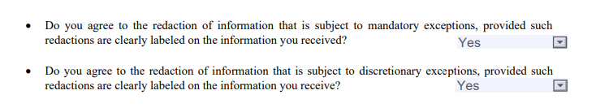
Quick Reminders about the TPIA
Consider allowing the use of the AG’s TPIA Request Form and posting a copy of the form on the district’s website

Slide 30
AG Opinion Number KP-0475
On October 2, 2024, Ken Paxton clarified notice requirements relating to going into closed session
Boilerplate language listing reasons the District may go into closed session is not enough to satisfy TOMA notice requirements
Notice requirements apply to closed sessions, so there must be a relevant agenda item in order to go into closed session

Slide 31
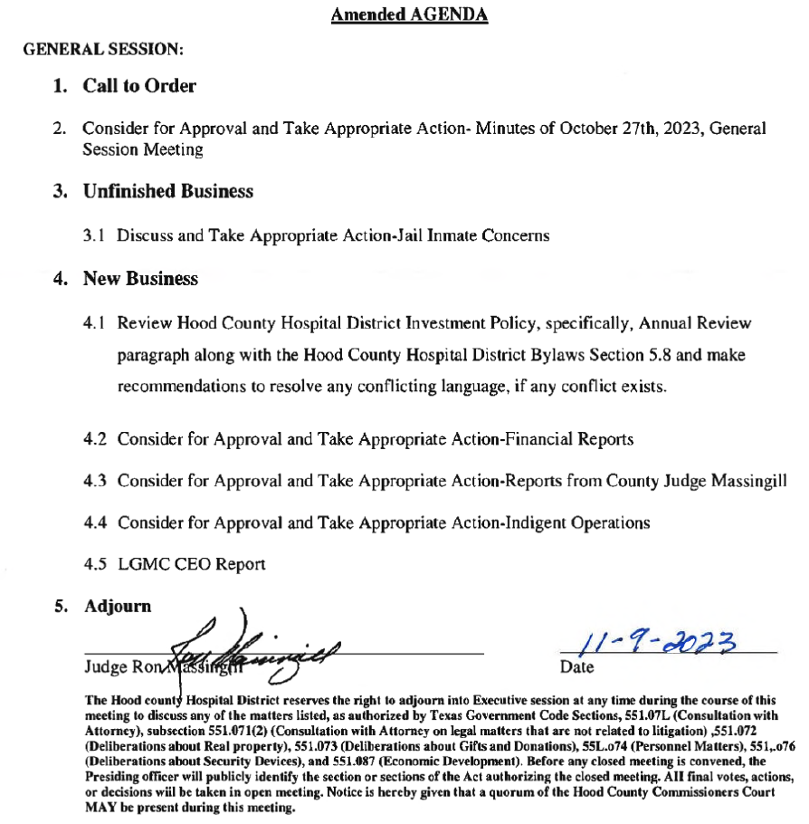

Slide 32
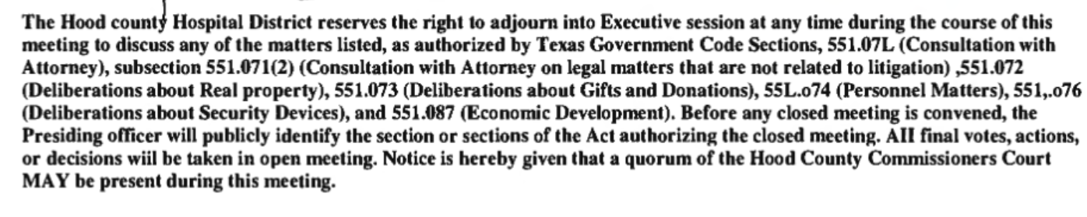

Slide 33
Webb County v. Mares
Webb County Commissioner’s Court voted to split its Administrative Services Department into two departments
Cynthia Mares was subsequently moved to a new position within the newly-created department at a lower salary
Six years later she sued the city for various reasons, including a TOMA violation alleging the agenda did not provide sufficient notice
2024 WL 5130862 (Tex. App.—Houston [14th Dist.] Dec. 17, 2024)

Slide 34
Webb County v. Mares
Agenda item:
  Discussion and possible action to adopt the county budget for fiscal year 2016-2017
A notice is sufficient if it informs the reader “some action” will be considered with regard to the topic
  “As long as the reader is alerted to the topic for consideration, it is not necessary to state all of the consequences which may flow from consideration of the topic.”
    Cox Enters., Inc. v. Bd. of Trustees, S.W.2d 956, 958 (Tex. 1986)

Slide 35
Webb County v. Mares
County argued the agenda item was sufficient because the department split and changes to employee compensation were part of the budget process
The agenda made no mention of splitting the Administrative Services Department or changing the job titles and salaries within it
Other changes to job descriptions or employee movement between departments were specifically listed in other parts of the agenda

Slide 36
Webb County v. Mares
Court held the County violated TOMA by not providing adequate notice of its actions
Governmental immunity precluded Mares from recovering money damages
TOMA permits recovery of attorney’s fees and costs, and the Mares were awarded $69,650 in attorney’s fees and costs

Slide 37
Elliott v. McKinley ISD
Paul Elliott filed a grievance with the ISD, alleging the district allowed electioneering during a joint Board meeting with the City of McKinley
Elliott also alleged a trustee improperly used an investigative report about another trustee in her election campaign
Tex. Comm’r of Educ. Decision No. 047-R10-04-2024 (Jan. 23, 2025)

Slide 38
Elliott v. McKinley ISD
Texas Education Code § 11.169 =
  “the board of trustees of an independent school district may not use state or local funds or other resources of the district to electioneer for or against any candidate, measure, or political party”

Slide 39
Elliott v. McKinley ISD
Issue 1: Did the trustee improperly use an investigative report about another trustee in her campaign?
  A trustee’s personal campaign actions are not the use of district resources
  The trustee did not violated TEC § 11.169

Slide 40
Elliott v. McKinley ISD
Issue 2: Did the ISD allow electioneering during its joint Board meeting with the City of McKinley?
  During the meeting, the mayor urged attendees to vote for 3 specific board members
  The Board President thanked the mayor for his comments
  The Commissioner opined a violation may have occurred because the mayor was an official participant in the meeting, but ultimately dismissed the appeal for failing to sufficiently plead a request for relief

Slide 41
Jaramillo v. Edgewood ISD
Jaramillo appealed a grievance to the Commissioner, seeking the removal of a trustee who allegedly falsified his residency for the election and violated TEC § 11.061 (requiring trustees to be a qualified voter)
A qualified voter must be a resident of the territory covered by the election for office (TEC § 11.001(a)(2))
Tex. Comm’r of Educ. Decision No. 079-R10-08-2024 (Dec. 10, 2024)

Slide 42
Jaramillo v. Edgewood ISD
Jaramillo’s original grievance sought the resignation of the trustee
The ISD dismissed her Level One Complaint as untimely, and Jaramillo never appealed to Level Two, so the Board did not review the grievance
The Commissioner concluded he lacked jurisdiction over the appeal

Slide 43
Jaramillo v. Edgewood ISD
The Commissioner noted that even if he had jurisdiction he could not grant the relief requested
  The Commissioner does not have the authority to remove a school board trustee, nor does the school board
  The only method for removing a school board trustee involves filing a quo warranto action in district court

Slide 44
N
Employment
W
E
S

Slide 45
King v. Lubbock ISD
Teacher signed an administrator term contract with the ISD and was assigned as campus principal
After the contract was signed, the ISD discovered the teacher lacked principal certification, reassigned her to a teaching position, and adjusted her pay
Tex. Comm’r of Educ. Decision No. 057-R2-05-2024 (May 30, 2024)

Slide 46
King v. Lubbock ISD
The teacher filed a grievance, alleging an improper demotion
While the grievance was pending, the Board voted to void her contract under TEC §21.0031
The teacher appealed the Board’s decision

Slide 47
King v. Lubbock ISD
TEC § 21.0031 states an employee’s Chapter 21 contract is void if the employee “does not hold a valid certificate or permit issued by [SBEC]”
A district that has knowledge the contract is void may take the following actions:
  terminate the employee;
  suspend the employee with or without pay; or
  retain the employee on an at will basis for the remainder of the year in a position that does not require the employee to be certified

Slide 48
King v. Lubbock ISD
An ISD’s decision under TEC §21.0031 is not subject to appeal under Chapter 21
The Commissioner dismissed for lack of jurisdiction because he did not have authority to hear an appeal under Chapter 21 and the complainant did not allege a violations of school law
Takeway: Chapter 21 contracts given to uncertified employees may be terminated as void without going through the steps

Slide 49
Yates v. Spring ISD
Weeks after hiring Yates as an 5th grade math teacher, the ISD placed him on a support plan due to performance concerns
After the other 5th grade math teacher resigned, the ISD was forced to combine classes and assigned a different teacher as the lead teacher for the combined classes
115 F.4th 414 (5th Cir. 2024)

Slide 50
Yates v. Spring ISD
Yates was reassigned toa “push-in” role assisting students in another class
When another math teacher resigned, Yates (age 67) was briefly assigned as the lead teacher until the ISD hired a younger teacher (due to Yate’s performance issues)
Yates was placed on another support plan and reassigned to assisting 3 students in the school library

Slide 51
Yates v. Spring ISD
Yates filed a complaint with the Equal Employment Opportunity Commission (EEOC)
He alleged discrimination and retaliation on the basis of his race, national origin, color, age, and disability under Title VII of the Civil Rights Act of 1964, the Age Discrimination in Employment Act of 1967, and the Americans with Disabilities Act of 1990
At his request, the ISD reassigned him to another campus, where he was eventually placed on administrative leave after the ISD received complaints from parents and students

Slide 52
Yates v. Spring ISD
After being returned from administrative leave, Yates sued the ISD based on the same issues he raised in his EEOC complaint
Generally, for discrimination and retaliation claims, an employee must establish a prima facie case:
  The employee belongs to a protected class; or,
  The employee suffered an adverse employment action; or,
  A causal connection exists between the adverse employment action and the employee’s status in a protected class

Slide 53
Yates v. Spring ISD
If the plaintiff establishes a prima facie case, the burden shifts to the defendant to demonstrate a legitimate reason for its actions
If the defendant meets this burden, the burden shifts back to the plaintiff to show the reasons offered by the defendant were a pretext

Slide 54
Yates v. Spring ISD
Here, the court assumed the plaintiff established a prima facie case, but noted the ISD met its burden to demonstrate legitimate reasons for its actions
Yates failed to show that reason was pretextual

Slide 55

Takeaway
Documentation supporting legitimate reasons for employment actions is critical

Slide 56
Crowley ISD v. Stoneham
ISD terminated Stoneham following his use of force against a student
The student was unauthorized to be in Stoneham’s classroom and failed to identify himself
Stoneham contacted the office, and the student grabbed and shoved Stoneham, attempting to leave the classroom
2025 WL 794046 (Tex. App. [15th Dist.] Mar. 13, 2025)

Slide 57
Crowley ISD v. Stoneham
Stoneham considered the student a threat and prevented the him from leaving by using his weight and pinning the student to the ground
Board terminated Stoneham for conduct “inconsistent with the conduct of a person of ordinary prudence under the same or similar circumstances”
Stoneham appealed his termination to the Commissioner
Commissioner determined the ISD used the wrong legal standard when voting to terminate Stoneham because it did not address TEC § 22.0512

Slide 58
Crowley ISD v. Stoneham
Texas Education Code § 22.0512:
  A professional employee of a school district may not be subject to disciplinary proceedings for the employee's use of physical force against a student to the extent justified under Section 9.62, Penal Code.

Slide 59
Crowley ISD v. Stoneham
Texas Penal Code § 9.62:
  The use of force, but not deadly force, against a person is justified:
  if the actor is entrusted with the care, supervision, or administration of the person for a special purpose; and
  when and to the degree the actor reasonably believes the force is necessary to further the special purpose or to maintain discipline in a group

Slide 60
Crowley ISD v. Stoneham
Under TEC § 22.0512, the District has the burden to prove the educator did not have an objectively reasonable belief that force was necessary
  Edinburg Consol. Indep. Sch. Dist. v. Villareal, 2020 WL 1857558 (Tex. App.—Corpus Christi—Edinburg April 9, 2020)
The Commissioner reversed Stoneham’s termination

Slide 61
Crowley ISD v. Stoneham
On appeal, the Court of Appeals held the Commissioner had the authority to substitute his judgment for the Board’s decision, concluding the Board’s decision, was arbitrary because it did not consider § 22.0512
  “The test is not whether Stoneham’s actions—divorced from the context of the entire altercation—were ‘reasonable.’ The test is whether Stoneham had a reasonable belief that the use force was necessary to compel obedience with the request to show ID.”

Slide 62
N
Grievances
W
E
S

Slide 63
Fred and Jarod Stats
 | 2021-22 | 2022-23 | 2023-24 | 2024-25 | Totals
Level Three FNG Hearings | 5 | 3 | 4 | 11 | 23
Level Three DGBA Hearings | 3 | 1 | 1 | 7 | 12
Commissioner Appeals | 2 | 0 | 0 | 2 | 4
TEA Complaints | 4 | 2 | 3 | 5 | 14
Totals | 14 | 6 | 8 | 25

Slide 64
Grievance Policies
PERSONNEL-MANAGEMENT RELATIONS: EMPLOYEE COMPLAINTS/GRIEVANCES | DGBA
STUDENT RIGHTS AND RESPONSIBILITIES: STUDENT AND PARENT COMPLAINTS/GRIEVANCES | FNG (LOCAL)
PUBLIC COMPLAINTS | GF (LOCAL)

Slide 65
Granger v. Morath
(Commissioner Jurisdiction & Waiver)
Facts:
  Lancaster ISD employed Granger as superintendent
  Just before a Board election, the Board voted to extend Granger’s contract for 5 years
  The incumbent chairperson lost re-election
  Before the new Board took office, the Board voted 4-3 to enter a voluntary separation agreement (“VSA”) with Granger
No. 14-23-00245-CV 2024 WL 2763387 *1, *1 (Tex. App.—Houston[14th Dist.] May 30, 2024)

Slide 66
Granger v. Morath
Under the terms of VSA, Granger:
  would be paid $2,036,567 dollars (salary for 5 years),
  would be assigned as Superintendent Emeritus, and
  Resignation became effective approximately 3 months following the election
At the following Board meeting, the newly elected trustee assumed office and the Board suspended Granger with pay
The following month, the Board voted to rescind the VSA and propose Granger’s termination

Slide 67
Granger v. Morath
Granger did not file a local grievance with the District
Instead, he filed a Petition for Review to the Commissioner of Education, claiming the District breached the VSA
  Granger asserted the Commissioner had jurisdiction under Education Code §7.057(a)(2)
  Granger claimed the Board’s action/discussion violated the VSA and caused him monetary harm

Slide 68
Let’s Pause to Remember Davis v. Morath
Commissioner dismissed teachers’ grievances because he concluded they were untimely and did not have jurisdiction
Texas Supreme Court held:
  Even if grievances were NOT timely, nothing in §7.057 conditions Commissioner jurisdiction on the timeliness or procedural validity of a complainant’s actions at the District/local level
Granger is the first case since Morath to address a failure to file a complaint at all
624 SW 3d 215 (Tex. 2021)

Slide 69
Granger v. Morath
Procedural History:
  Commissioner of Education originally determined that:
    Because Granger did not file a local level grievance, he failed to exhaust administrative remedies and deprived the Commissioner of jurisdiction
    There was no Local Record, the Commissioner could not render a decision and the claim was waived
  Granger appealed to the state district court

Slide 70
Granger v. Morath
Issue No. 1 - Did the Commissioner have jurisdiction?
  Section 7.057 permits an appeal of a person aggrieved by the following:
    The school laws of this state; or
    Actions or decisions of any school district board of trustees that violate:
      The school laws of this state; or
      A provision of a written contract between the school district and a school district employee, if a violation causes or would cause monetary harm to the employee
  Looking at the plain language of the statute, the Court of Appeals ruled the Commissioner had jurisdiction, even though Granger had not filed a local grievance

Slide 71
Granger v. Morath
Issue No. 2 - Did Grainger waive his complaint to the Commissioner by failing to file a grievance?
  “LISD could not and did not address the merits of [a] grievance or give its reasons for taking the challenged actions. For this reason, the Commissioner is likewise precluded from reaching the merits.”
  Even though the Commissioner had jurisdiction, he could not reach the merits of the grievance because Granger failed to follow the District’s local grievance process

Slide 72
Takeaway
  Even though the Commissioner of Education has jurisdiction over grievances arising from Board actions or decisions outside a grievance proceeding, failing to follow a District’s local grievance process may result in waiving the claim
  TIP - Follow your timelines to preserve all defenses

Slide 73
Parent v. Spring Branch ISD
(Appeals to the Board Required)
FACTS:
  A teacher found a student cheated on a test and changed the student’s grade to zero
  Parent filed two grievances, administration consolidated them into one, claiming the teacher’s allegations of cheating were baseless and unethical
  Parent requested the removal of the academic dishonesty charge from the student’s record and requested a FERPA hearing under Board Policy FL(LOCAL)
Tex. Comm’r of Educ. Docket No. 070-R10-07-2024 (March 17, 2025)

Slide 74
Parent v. Spring Branch ISD
The Level One administrator found no unethical conduct occurred and granted the request for a FERPA hearing under Board Policy FL(LOCAL)
The District later held the FERPA Hearing under FL(LOCAL) and declined to amend the student’s records
Before and during the FERPA Hearing, the parent filed additional grievances and appeals, but the District’s response to her appeals were moot because the Level One Response already addressed her requested remedies

Slide 75
Parent v. Spring Branch ISD
Parent filed a Level Three Appeal to the Board, but the associate superintendent informed her the appeals were dismissed due to mootness
Board never heard the Parent’s Complaints
Parent filed a petition for review with the Commissioner of Education, arguing the District denied her the opportunity to present her grievance to the Board

Slide 76
Parent v. Spring Branch ISD
The Commissioner of Education agreed, finding:
  the parent did not have the opportunity to present her grievances to the Board, concluding school boards have the final authority on grade disputes;
  parents have a right to present grievances to the Board (TEC §§11.1511(b)(13) and 26.011); and
  This parent had a right to her present grievances to the Board
The Commissioner remanded to the case to the District for the Board to hear the grievance

Slide 77
Takeaways
  Provide complainants the opportunity to submit their grievance to the Board
  Procedural missteps may not change the final outcome, but can prove costly in time and money

Slide 78
Takeaways
  Commissioner is limited in remedies on appeal:
    Affirm, reverse, remand
    Cannot substitute his judgement for the Board, unless the discussion was arbitrary capricious, unlawful or not supported by substantial evidence (19 T.A.C. 157.1073(h)
    Cannot take independent action to remedy Board Action

Slide 79
Parent v. Klein ISD
(Fair Hearing Required)
FACTS:
  Parent filed a grievance regarding her child’s records
  District grievance procedures stated that an appeal to the Board would be heard by a hearing officer, who would hear the grievance then provide a written recommendation to the Board
  After receiving the written recommendation, the Board would review the recommendation at its next regular meeting, but no testimony or evidence would be taken
Tex. Comm’r of Educ. Docket No. 002-R10-09-2023 (May 7, 2024)

Slide 80
Parent v. Klein ISD
Parent argued she did not receive a fair hearing because:
  the hearing officer was a former District employee;
  student records were not properly documented and she was denied the ability to correct those issues with a second Level Three Hearing; and,
  She was not given sufficient time to address the Board (parent allotted 2 minutes)

Slide 81
Parent v. Klein ISD
The Commissioner concluded:
  a hearing examiner’s prior employment does not automatically make the assignment as a hearing examiner unfair
  Complainants to not automatically get a second Level Three Hearing by claiming errors were made at the initial Level Three Hearing
  Complainants are entitled to a fair hearing before the Board of Trustees
    The Commissioner will determine this based upon the parties' contentions and the Record of the Board Hearing

Slide 82
Parent v. Klein ISD
The Commissioner has rules regarding the Local Record:
  “[T]he school district to make and preserve the records of the proceedings before the board of trustees. If the school district fails to create and preserve the record without good cause, all substantial evidence issues that require missing portions of the record for resolution shall be deemed against the school district. The record shall include: . . .”
19 Tex. Admin. Code § 157.1073(d)

Slide 83
Parent v. Klein ISD
  the transcripts of proceedings at the local level;
  all admitted evidence;
  all offers of proof;
  all written pleadings, motions, and intermediate rulings;
  a description of all matters officially noticed;
  if applicable, the recommendation of the independent hearing examiner;
19 Tex. Admin. Code § 157.1073(e)

Slide 84
Parent v. Klein ISD
  the transcript of the oral argument before the board of trustees or the board subcommittee;
  the decision of the board of trustees or the board subcommittee; and
  if applicable, the board of trustees' or the board subcommittee's written reasons for changing the recommendation of the independent hearing examiner
19 Tex. Admin. Code § 157.1073(e)

Slide 85
Parent v. Klein ISD
Here, the Local Record was missing a recording or transcript of the oral argument before the Board T
The issue of whether the parent was provided a fair opportunity to present her grievance is deemed against the District
The remedy is that the case is remanded back to the Board with instructions for the Board to provide the parent a fair Hearing

Slide 86
Takeaways
  Level Three Hearings must be recorded or transcribed
  The Local Record must include a copy or transcription of the Level Three Hearing
  Procedural misstep may result in having to conduct the Level Three Hearing again
  Complainants are entitled to review and respond to the evidence
    Thomas v. Fort Worth ISD, Tex. Comm’r of Educ., Docket No. 070-R10-603 (March 25, 2004)

Slide 87
N
Executive Orders
W
E
S

Slide 88
Executive Order 14242 (3/25/25)
Improving Education Outcomes by Empowering Parents, States and Communities; Activities Reducing and Dismantling the Department of Education
  Seeks close the U.S. Department of Education
  Directs the Secretary of education to:
    “take all necessary steps to facilitate the closure of the Department of Education”
    “ensure the allocation of . . . funds is subject to rigorous compliance with Federal law and Administration policy, including the requirement that any program or activity receiving Federal assistance terminate illegal discrimination obscured under the label “diversity, equity, and inclusion” or similar terms and programs promoting gender ideology”

Slide 89
Executive Order 14242
Possible effects
  Reduced investigative capacity
  Slower case resolution for OCR complaints
  Enforcement actions follow the Administration’s prioritized issues
  Potential funding loss

Slide 90
Department of Education
According to EdWeek, the U.S. Department of Education has initiated 18 investigations into school districts since the new administration took over. The following is a break down of the focus of the investigations:
  Race-based programming (DEI): 3
  Transgender student policies: 12
  Antisemitism: 2
  Services for students with disabilities:1

Slide 91
Executive Order 14242
This EO is facing numerous legal challenges, but is currently in effect
  Most cases seek a preliminary injunction against further action under this EO and a declaration the EO is unlawful
Somerville Public Schools v. Trump, No. 1:25-cv-10677 (D. Mass., filed 03/24/25)
NAACP v. U.S.A., No. 8:25-cv00965 (D. Md., filed 3/24/25)

Slide 92
Executive Order 14168 (1/20/25)
Defending Women From Gender Ideology Extremism and Restoring Biological Truth to the Federal Government
  Directs all federal agencies and employees to “enforce laws governing sex-based rights, protections, opportunities, and accommodations to protect men and women as biologically distinct sexes

Slide 93
Executive Order 14168
  Directs the Attorney General to:
    “[I]ssue guidance to agencies to correct the misapplication of the Supreme Court’s decision in Bostock v. Clayton County (2020) to sex-based distinctions in agency activities” and “issue guidance and assist agencies in protecting sex-based distinctions, which are explicitly permitted under Constitutional and statutory precedent.”
  Translation for Schools:
    The Supreme Court decision in Bostick that protected transgender persons under Title VII in the employment context does not carry over to schools in the Title IX context

Slide 94
Executive Order 14168
“Federal funds shall not be used to promote gender ideology. Each agency shall assess grant conditions and grantee preferences and ensure grant funds do not promote gender ideology.”

Slide 95
Executive Order 14168
This EO is also facing legal challenges
  State of Minnesota seeks an order that the EO violates U.S. constitutional and federal law and violates states’ anti-discrimination laws
  DOJ sued Maine’s Department of Education arguing that it is openly violating Title IX because it has a policy allowing transgender females to participate in girls’ sports
  State of Minnesota v. Trump, No. 0:25- cv-01608 (D. Minn. Filed 4/22/25)
  U.S.A. v. Maine Department of Education, 1:25-Cv00173 (D. Me., filed 4/16/25)

Slide 96
Executive Order 14168
Although UIL rules in Texas require students to participate based on the sex listed on their official birth certificate, the DOJ’s lawsuit against Maine’s Department of Education illustrates how the current administration intends to enforce its guidance pursuant to the president’s executive orders

Slide 97
Navigating the Latest Developments in School Law
Spring Workshop - Canyon - 2025
5/21/2025
2:45 PM - 3:45 PM
CEC 6857
You must report credit within 24 hours.
Visit tasb.org/mycec and log in using TASB login.

